Slide 1
Presentation on “Mining Classification Rules from Database Using Artificial Neural Networks”
Guided by:
Prof Mrs. S. V. shinde
Presented By:
Mr. Prashant P. Avaghade
Mr. Nikhilesh Shinde
Mr.Mahesh Kshatriya
Mr.Datta Diware
Mr.Sumit Wankhede
Pimpri Chinchwad College of Engineering
Dept of Information Technology
Pune-44

Slide 2
Outline
Overview of the Project
Fundamentals
Details of Literature Survey
High Level Design
Application
Conclusion

Slide 3
Overview
Domain
Data mining
Neural Network
Scope
Business Intelligence
Credit Scoring
Issue
Commercial
Business Intelligence

Slide 4
Fundamentals
Data Mining Classification
Decision Tree Technique
Neural Network
-Feed-Forward NN
Network Training
Network Pruning
C 4.5
SVM

Slide 5
Literature survey
Wei-Sen Chen and Yin-Kuan Du have used the artificial neural network (ANN) and data mining (DM) techniques to construct the financial distress prediction model.
Humar Kahramanli and Novruz Allahverdi have presented the technique of mining the classification rules for Liver Disorders using adaptive activation function.
Many of the algorithms frequently assume that the input data attributes are discrete in order to make the rule extraction process more manageable.
Ex.: NeuroRule, Rule eXtraction (RX), generalized analytic rule extraction (GLARE) algorithm, orthogonal search-based rule extraction (OSRE) method.
RE-RX Works on data sets having both discrete and continuous attributes.

Slide 6
Feed-Forward Neural Network
X₁
X₂
f(V)
∑x_{i}w_{i}
Y_{k}
X₃
B₁
X₄
Input Signals
Summing Junction
Activation Fuction

Slide 7
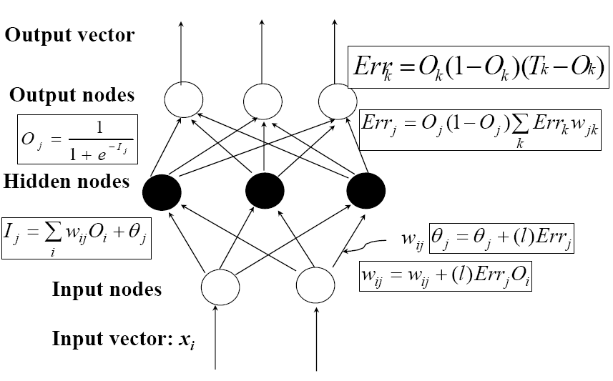
Network Training
Gradient descent/error back propagation

Slide 8
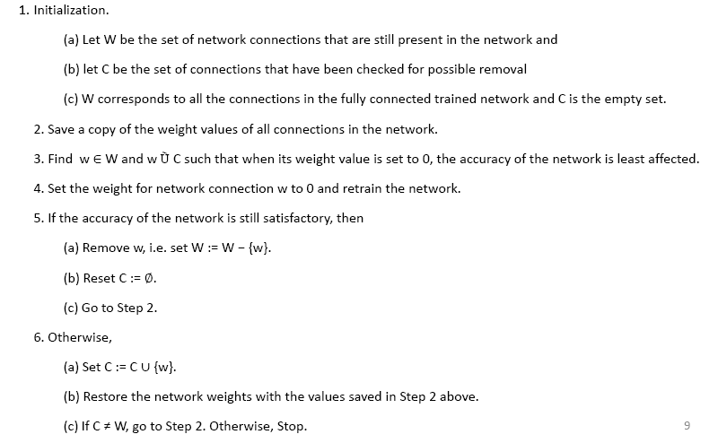
Network Pruning

Slide 9
C 4.5 (Decision Tree)
Outlook
sunny
overcast
rain
Humidity
Yes
Windy
high
normal
true
false
No
Yes
No
Yes

Slide 10
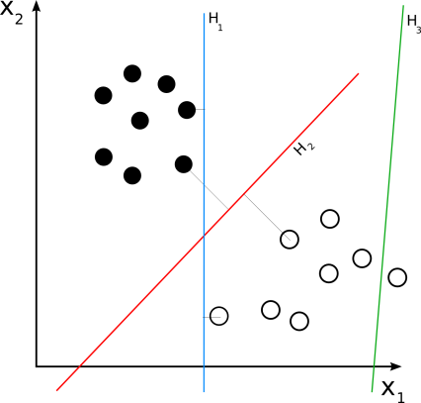
A support vector machine constructs a hyper plane or set of hyper planes in a high or infinite dimensional space, which can be used for classification, regression, all other tasks
Support Vector Machine

Slide 11
Algorithm
Algorithm Re‐RX(S, D, C):
Input: A set of samples S having discrete attributes D and continuous attributes C
Output: A set of classification rules
1. Train and prune a neural network using the data set S and all its attributes D and C.
2. Let D' and C' be the sets of discrete and continuous attributes still present in the network, respectively. Let S' be the set of data samples that are correctly classified by the pruned network.
3. If D' = NULL , then generate a hyperplane to split the samples in S' according to the values of their continuous attributes C' and stop. Otherwise, using only discrete attributes D', generate the set of classification rules R for the data set S'.

Slide 12
Algorithm(cond.)
4. For each rule Ri generated:
If support(Ri) > σ1 and error(Ri) > σ2, then:
Let Si be the set of data samples that satisfy the condition of rule Ri, and Di be the set of discrete attributes that do not appear in the rule condition of Ri.
If Di = NULL, then generate a hyperplane to split the
samples in Si according to the values of their continuous attributes Ci and stop.
5. Otherwise, call Re‐RX(Si, Di, Ci)

Slide 13
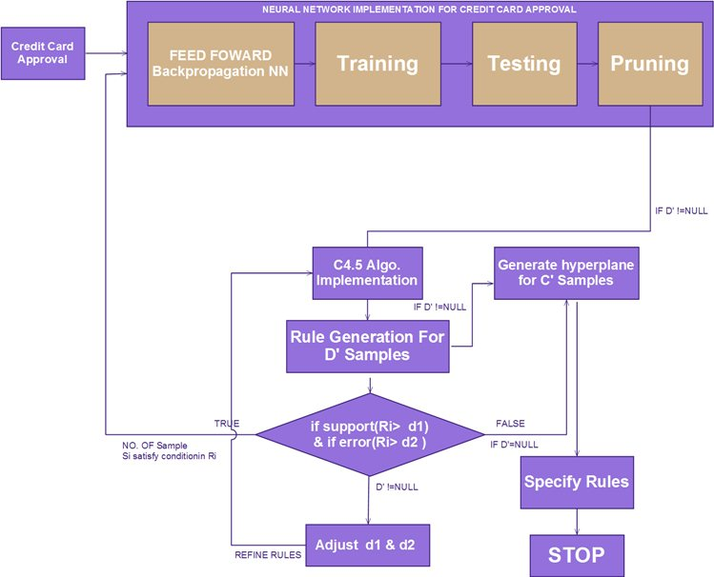
System Process Flow

Slide 14
Tools
Windows XP Platform
MATLAB NNToolbox
JAVA Environment
WEKA (j48,SMO)

Slide 15
IMPLEMENTATION & TESTING
Network Architecture
Network setup
Rules generated using Discrete Attributes:
Rule R1: If D2<=154 and D2<=100 and D5<=25, then Predict class 0
Rule R2: If D2<=154 and D2<=100 and D5>25 and D1<=10 and D3<=52, then Predict Class1
Rule R3: If D2<=154 and D2<=100 and D5>25 and D1<=10 and D3>52, then Predict Class0
Rule R4: If D2<=154 and D2<=100 and D5>25 and D1>10, then Predict Class 1
Rule R5: If D2<=154 and D2>100 and D5<=28, then Predict Class0
Rule R6: If D2<=154 and D2>100 and D5>28 and D5<=58 and D3<=76, then Predict Class0

Slide 16
Rule R7: If D2<=154 and D2>100 and D5>28 and D5<=58 and D3>76 and D4<=21, then Predict Class0
Rule R8: If D2<=154 and D2>100 and D5>28 and D5<=58 and D3>76 and D4>21, then Predict Class1
Rule R9: If D2<=154 and D2>100 and D5>58, then Predict class0
Rule 10: If D2>154 then, Predict Class 1
Testing
NN result with 20 hidden nodes:
Training+ validation | Correctly Classified | Wrong Classified | %Accuracy
366 | 357 | 9 | 97.54%
Testing Samples | Correctly Classified | Wrong Classified | %Accuracy
166 | 121 | 45 | 72.89%

Slide 17
Rules Table:
 | No. of samples | Correctly classified | Wrong Classified | %Support | %Error
R1 | 62 | 62 | 0 | 17.32 | 0
R2 | 2 | 2 | 0 | 0.56 | 0
R3 | 45 | 42 | 3 | 12.57 | 6.67
R4 | 4 | 3 | 1 | 1.12 | 25
R5 | 97 | 79 | 18 | 27.09 | 18.56
R6 | 52 | 30 | 22 | 14.52 | 42.31
R7 | 5 | 5 | 0 | 1.4 | 0
R8 | 31 | 25 | 6 | 8.66 | 19.35
R9 | 8 | 8 | 0 | 2.23 | 0
R10 | 52 | 45 | 7 | 14.52 | 13.45
 | 358 | 301 | 57

Slide 18
Applications
Customer Segmentation
Image Classification.
Vegetation Classification.
Credit scoring
Intranet fraud classification.

Slide 19
Future Enhancement
Optimization of the rules
Proposed algorithm does not preserve accuracy when class label of the data are best describe as nonlinear function of continuous input, more research is required in this area.

Slide 20
Conclusion
Artificial neural networks have demonstrated good predictive performance in many app.
However, not considered sufficient for knowledge representation because of “black box” property.
A neural networks with higher predictive accuracy, and with a rule extraction algorithm, the drawback of ‘‘black box” neural network prediction can be overcome.

Slide 21
Thank You.
Any???
Notes:
Epoch,learning rate,other NN,traditional DM classification,MATLAB toolbox,performance comparison,accuracy

